Slide 1

Student College and Stream Preference Analysis and Recommendation System
TY ECE AIML D
G1 BATCH
Course: Database Management System
By
Devish Darne 1262252298
Jeel Bakrania 1262252386

Slide 2
Presentation flow
Introduction
  Brief overview of the project and problem statement
Project Aims and Objectives
  Key goals and intended outcomes
Background & Existing System
  Current situation and its limitations
Proposed System
  Features and improvements over the existing system
Software Requirements & Tools Used
  Hardware/software specifications
  Development tools, frameworks, and database
System Design
  Front-End Design (UI/UX, user interaction flow)
  Back-End Design (server logic, database connectivity, APIs)
  ER Diagram (database relationships)
  Table Design (Schema)
System Implementation
  Integration of front-end, back-end, and database
  Key modules and workflows
Results & Discussion
  Outputs, screenshots of the website, and performance analysis
Applications
  Real-world usage and industry relevance
Conclusion & Future Scope
  Summary and possible extensions
References
  Sources, research papers, tools consulted

Slide 3
Introduction
Project Overview
The Student College and Stream Preference Analysis and Recommendation System is an educational decision-support application developed using Python, PostgreSQL, and Stream lit. It analyzes student preferences to identify popular colleges, preferred academic streams, and frequently selected college–stream combinations. The system also generates recommendations using frequency-based and ranking-based logic.
Problem Statement
Choosing the right college and academic stream can be a complex and time-consuming process.
Students must compare multiple preferences and academic options to make informed decisions.
Manual analysis of student preferences makes it difficult to identify trends and popular choices.
A centralized, automated system is needed to analyze preference data and provide meaningful recommendations.

Slide 4
Project Aims and Objectives
Aim
To develop an integrated, data-driven system that analyzes student college and academic stream preferences and generates recommendations to support informed educational decision-making.
Key Objectives
Database Management: Store and manage student preference records using PostgreSQL.
Preference Analysis: Use Python to analyze student preferences and identify meaningful trends.
Priority Distribution: Examine preference rankings and identify the relative importance of student choices.
Popular Choice Identification: Determine the most frequently preferred colleges and academic streams.
Recommendation Generation: Rank college–stream combinations using frequency- and ranking-based logic.
Data Enhancement: Incorporate additional attributes such as Class XII score, gender, and age for further analysis.
Intended Outcomes
Simplify the exploration of college and stream preferences.
Provide an interactive platform for data-driven educational decision support.
Establish a foundation for future personalized and machine-learning-based recommendations.

Slide 5
Background & Existing System
Background
Selecting an appropriate college and academic stream is an important decision that influences a student's educational and professional future. Students consider multiple factors, including academic performance, personal preferences, college popularity, and stream selection.
Limitations of the Existing System
Time-Consuming: Requires considerable effort to compare student preferences.
Limited Analytical Insights: Difficult to identify trends across large datasets manually.
Lack of Automation: Preference analysis and ranking require manual effort.
Limited Visualization: Preference patterns may not be presented through interactive dashboards.
Inconsistent Decision Support: Comparing multiple college–stream combinations can be challenging.

Slide 6
Proposed Solution
Key Features
Centralized Database: Stores and manages student preference records using PostgreSQL.
Automated Data Analysis: Processes student data using Python to identify preference patterns and distributions.
College & Stream Ranking: Identifies popular colleges, preferred academic streams, and frequently selected combinations.
Recommendation Engine: Generates ranked college–stream recommendations based on preference frequency and ranking.
Interactive Dashboard: Provides Analysis, Recommendations, and Raw Data tabs using Stream lit.
Demographic Analysis: Supports analysis of additional attributes, including Class XII score, gender, and age.
Data Visualization: Presents analytical results through charts, graphs, and tables.
Improvements Over the Existing System
Reduces manual effort through automated preference analysis.
Makes student preference trends easier to identify and interpret.
Combines database storage, analysis, recommendations, and visualization in one platform.
Enables convenient exploration of results through an interactive interface.
Provides a modular and scalable foundation for future machine-learning integration.

Slide 7
Software Requirements & Tools Used
Software Requirements
Operating System: Windows
Programming Language: Python
Database Management System: PostgreSQL
Web Application Framework: Stream lit
Data Processing: Python-based data analysis and SQL queries
Visualization: Charts, graphs, and tables through the dashboard
Tools Used
Python, PostgreSQL, Stream Lit

Slide 8
System Design
System Design Slide
Technology: Stream lit
Provides an interactive, web-based interface for exploring student preference data.
Allows users to explore analytical results and student records without directly executing SQL queries or Python code.
Back-End Design
Technologies: Python, PostgreSQL, SQL
Python connects to PostgreSQL to retrieve and update student preference records.
Python analyses student preferences and calculates distributions and frequency statistics.
Combines college–stream frequency and preference ranking to generate recommendations.

Slide 9
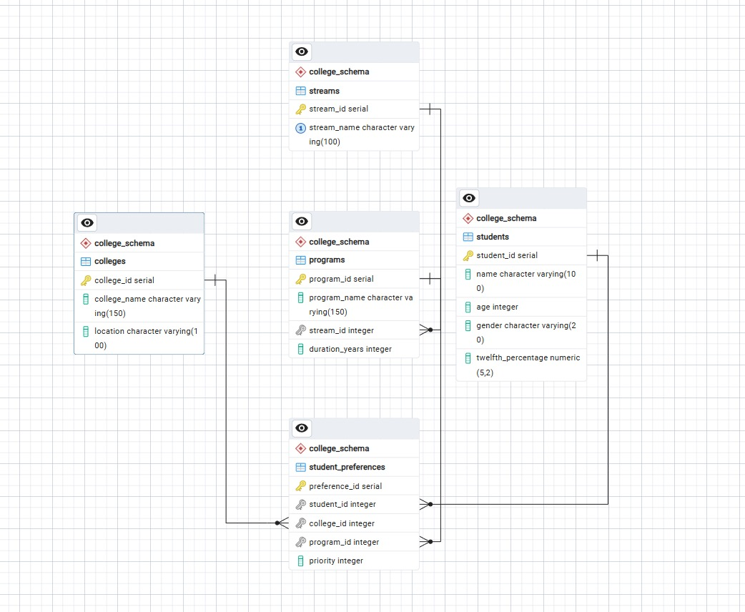
ER Diagram

Slide 10
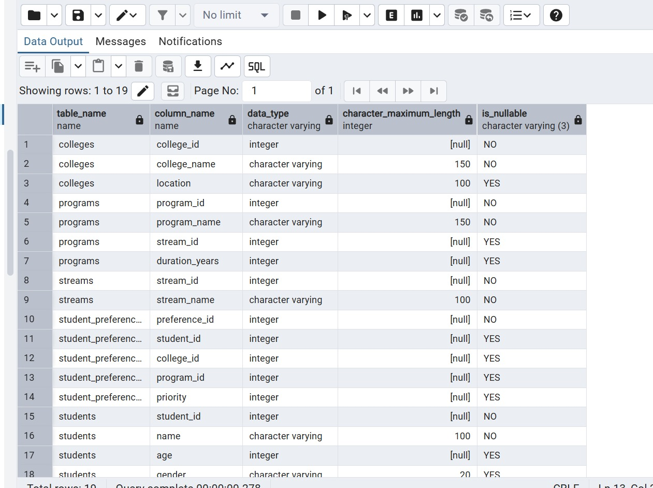
Table Design (Schema)

Slide 11
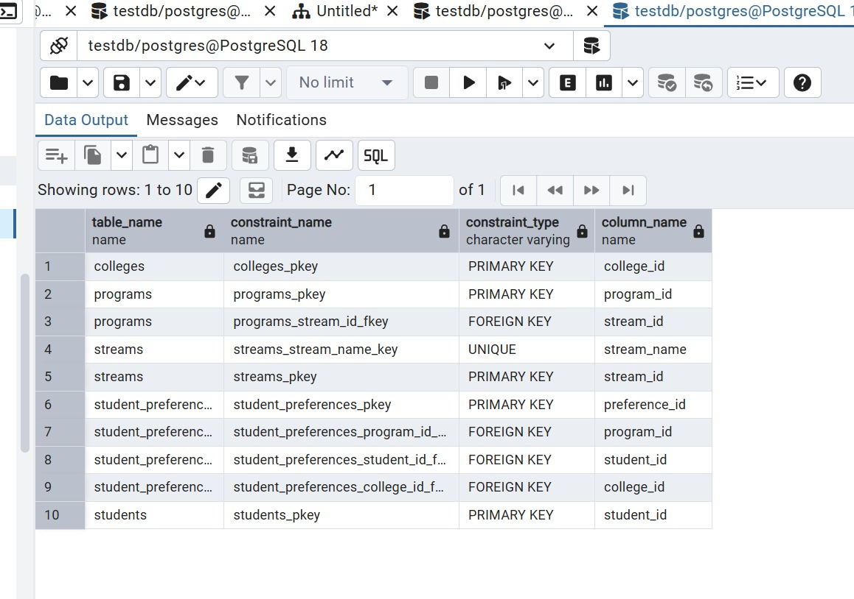

Slide 12
System Implementation
Integration of Front-End, Back-End & Database
The system integrates Stream lit, Python, and PostgreSQL to provide an interactive platform for student preference analysis and college–stream recommendations.
Front-End — Stream lit: Displays analytical results, recommendations, and student records through three interactive tabs.
Back-End — Python: Handles database connectivity, data processing, preference analysis, recommendation generation, and visualization.
Database — PostgreSQL: Stores and manages student records, including college preferences, stream preferences, priorities, Class XII scores, gender, and age.
System Workflow
Store student preference records in PostgreSQL.
Retrieve the required data using Python and SQL.
Analyze preference patterns and calculate statistics.
Generate ranked college–stream recommendations.
Display results through dashboard charts, graphs, and tables.

Slide 13
Applications
Real-World Applications
Educational Institutions: Analyze student preferences to understand popular colleges and academic streams.
Student Counselling: Support students in exploring college–stream combinations based on preference trends.
Admission Planning: Help institutions understand the distribution and popularity of student choices.
Educational Data Analytics: Identify preference patterns, priority distributions, and demographic trends.
Academic Decision Support: Present data-driven insights through interactive dashboards for easier interpretation.
Industry Relevance
EdTech Platforms: Integrate preference analysis into educational guidance applications.
Educational Consultancy: Use preference trends to support college-selection counselling.
Institutional Management: Support data-informed planning and understanding of student demand.
Database & Analytics Solutions: Demonstrate the practical integration of PostgreSQL, Python, and Stream lit.

Slide 14
Conclusion & Future Scope
Conclusion
Developed an educational analytics and recommendation system using Python, PostgreSQL, and Stream lit. Analyzed 506 student records to identify priority distributions, popular colleges, preferred academic streams, and college–stream combinations. Implemented frequency- and ranking-based recommendation logic to support educational decision-making. Created an interactive dashboard with Analysis, Recommendations, and Raw Data tabs. Demonstrated the integration of database management, data analytics, recommendation logic, and visualization in a unified application.
Future Scope
Machine Learning Integration
Personalized Recommendations
Additional Parameters
Historical Data Analysis
Advanced Recommendation Techniques
Scalability

Slide 15

Sustainable Development Goal 4: Quality Education
“Ensure inclusive and equitable quality education and promote lifelong learning opportunities for all.”
Connection to Our Project
The Student College and Stream Preference Analysis and Recommendation System supports UN Sustainable Development Goal 4 (Quality Education) by promoting data-driven educational decision-making.
Informed Educational Choices: Helps students explore college and academic stream preferences through data analysis and recommendations.
Access to Information: Presents student preference trends in an organized, interactive dashboard.
Evidence-Based Decision-Making: Helps identify popular colleges, preferred streams, and student priority patterns.
Improved Educational Guidance: Provides a foundation for more personalized college-selection support.
Scalable Educational Analytics: Can be extended with real admission data and machine learning to improve recommendation relevance.
Relevant SDG 4 Target
Target 4.3: By 2030, ensure equal access for all women and men to affordable and quality technical, vocational, and tertiary education, including university.
Expected Impact
The project contributes to the broader goal of quality education by making student preference information easier to analyze and use for educational guidance. With further development, it could support more personalized and inclusive college-selection assistance.

Slide 16
References
[1] C. Romero and S. Ventura, "Educational data mining: A review of the state of the art," IEEE Trans. Syst., Man, Cybern. C, Appl. Rev., vol. 40, no. 6, pp. 601–618, Nov. 2010.
[2] PostgreSQL Global Development Group, "PostgreSQL Documentation."[Online].Available:https://www.postgresql.org/docs/. Accessed: Aug 28, 2026.
[3]Python-Software Foundation, “Python Documentation." [Online]. Available: https://docs.python.org/3/. Accessed: Aug. 28, 2026.
[4] Streamlit Inc., "Streamlit Documentation." [Online]. Available: https://docs.streamlit.io/. Accessed: Aug. 28, 2026.
[5] W. McKinney, Python for Data Analysis: Data Wrangling with Pandas, NumPy, and I Python, 3rd ed. Sebastopol, CA, USA: O'Reilly Media, 2022.
[6] C. C. Aggarwal, Recommender Systems: The Textbook. Cham, Switzerland: Springer, 2016.
[7] F. Ricci, L. Rokach, and B. Shapira, Eds., Recommender Systems Handbook, 2nd ed. New York, NY, USA: Springer, 2015.

